Slide 1
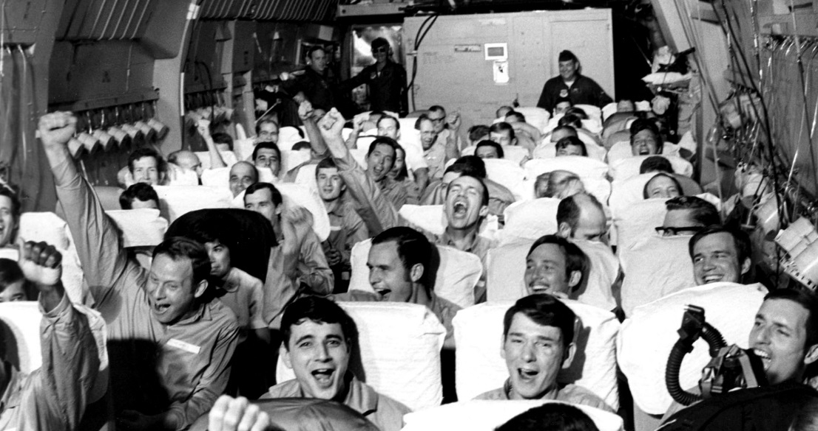
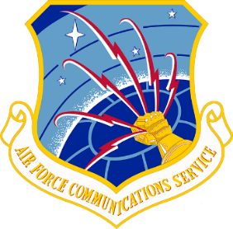
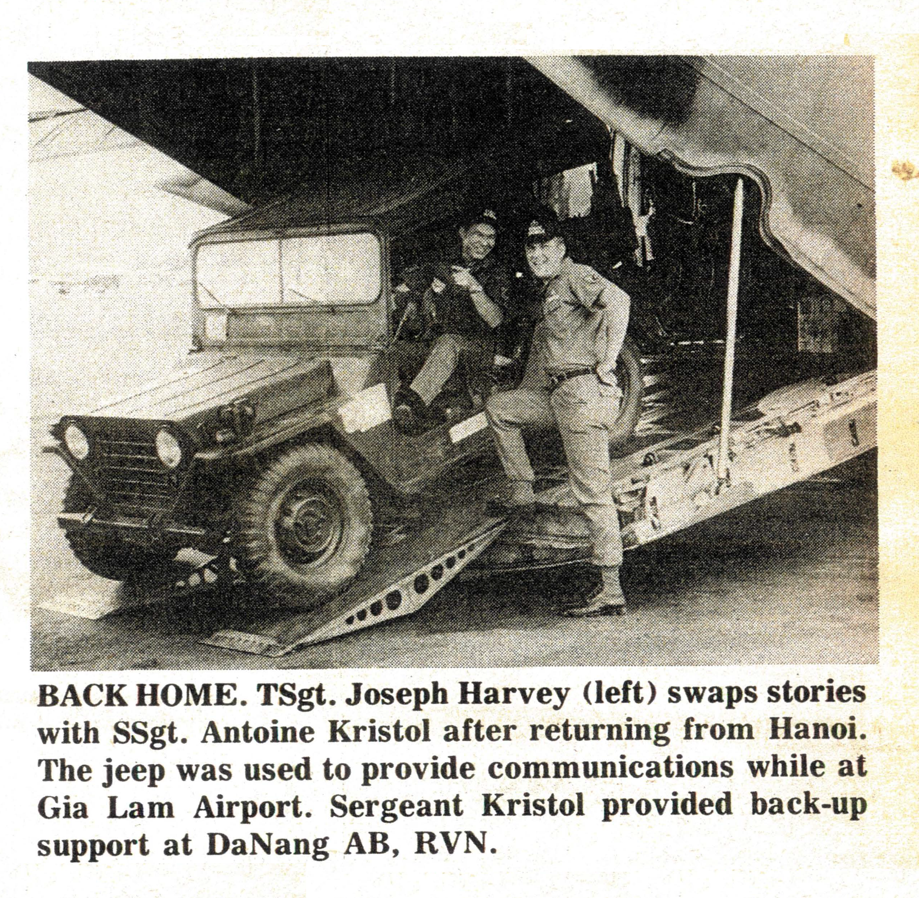
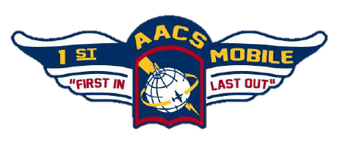
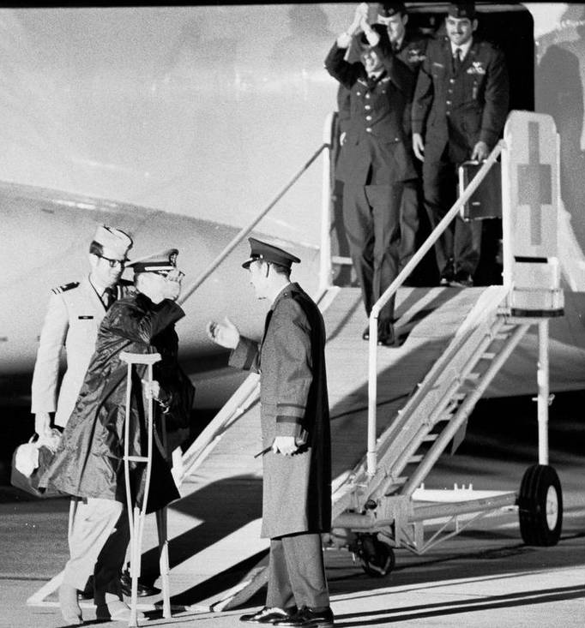
History Highlight
12 Feb 1973~ AFCS’s 1st Mobile Communications Group supported Operation Homecoming, the repatriation of American POWs from North Vietnam.
Living up to the group’s motto “first in – last out” the
1st MOB was on the first aircraft to land at Gia Lam
Airport in Hanoi, North Vietnam, and on the last aircraft to depart.
AFCS provided primary comm capabilities in Hanoi, a backup site in Da Nang, and phone lines and circuits to connect former POWs
to their families in the US.
Worldwide aeromedical evacuation
was concentrated at Scott and nearly all
returning POWs came through the base en route to their final destinations.
7 AFCS deployments supported 54 C-141 missions repatriating 591 American POWs
Notes:
Captions (clockwise):
- Air Force Communications Service emblem
- Newly freed US POWs aboard a C-141 from Hanoi, 28 Mar, 1973
- Unofficial 1st AACS Squadron Mobile emblem
- Navy Cmdr Raymond Vohden greeted by MAC/CV at Scott AFB 14 Feb 1973
- TSgt Joseph Harvey & SSgt Antoine Kristol AN/MRC-108 Radio Jeep; AFCS Intercom, 9 Mar 1973, pg 1
--------------------------------------------------------------------------------------
-Navy Cmdr. Raymond Vohden is the first man off the C-141 Starlifter and is greeted by the Military Airlift Command Vice-chair Lt. Gen. Jay T. Robbins. The POW's were released a few days earlier by North Vietnam and arrived at Scott Air Force Base at 11:05 p.m., Feb. 14, 1973, on their journey home.
-Vohden captivity (65-73)
-Total of 591 POWs from Hanoi. Consisted of 7 trips into Hanoi with a backup at Da Nang. One Mobster and a AN/MRC-­108 radio jeep per location. These seven Mob deployments supported a total of 54 C­‐141 missions, which carried 40 POWs each
-1st Combat Communications Squadron / 435th Air Ground Operations Wing / Ramstein AB, Germany
1st Mobile Communications Group participated in Operation Homecoming, the repatriation of American prisoners of war held by the North Vietnamese. Living up to the command’s motto of the first in and the last out, the group’s personnel were on the first aircraft to land at Gia Lam Airport in Hanoi, North Vietnam, and were on the last aircraft to depart. Within 10 minutes of the initial landing at Hanoi, the group established contact with Clark AB, Philippines, and the first C-141 medical evacuation aircraft was on its way to pick up the prisoners. Meanwhile, at Clark AB, other AFCS combat communicators helped set up hundreds of telephone lines and circuits for the free Americans to call their families and friends in the United States.

